Slide 1



Self Introduction
By Eason
#3123358222

Slide 2


Where l Am From——Xi'an
Long history
Numerous historical sites
Many prestigious universities
The capital of several dynasties——
Western Zhou、Qin、Western Han、Xin、Eastern Han、Western Jin、Former Zhao、Former Qin
Terracotta Army、Dayan Pagoda、Daming Palace Site、Weiyang Palace Site、Xingjiao Pagoda
——UNESCO《The World Heritage List》
XJTU、NPU、XU、NWAFU、SNU ...

Slide 3
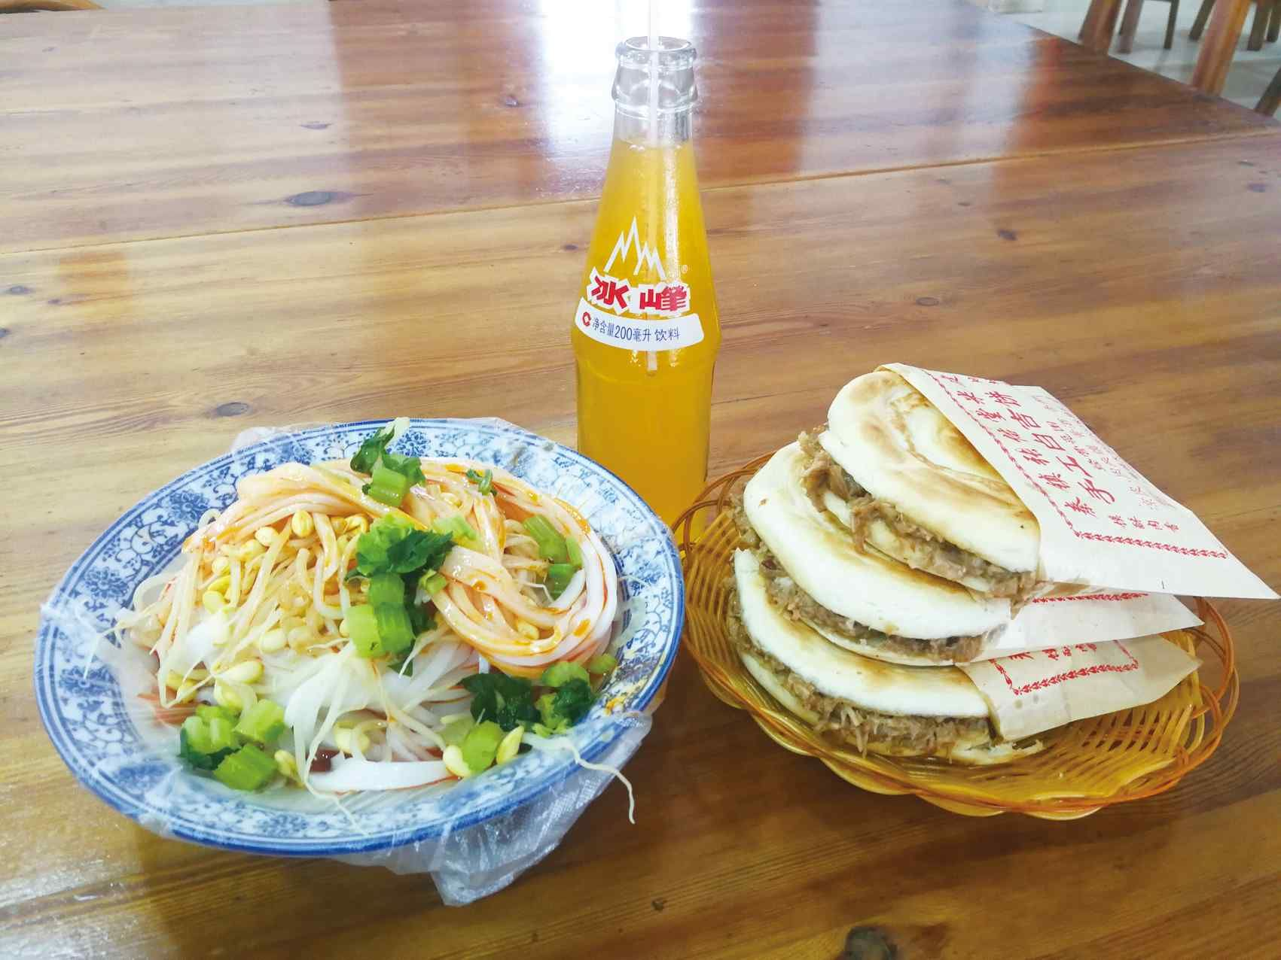
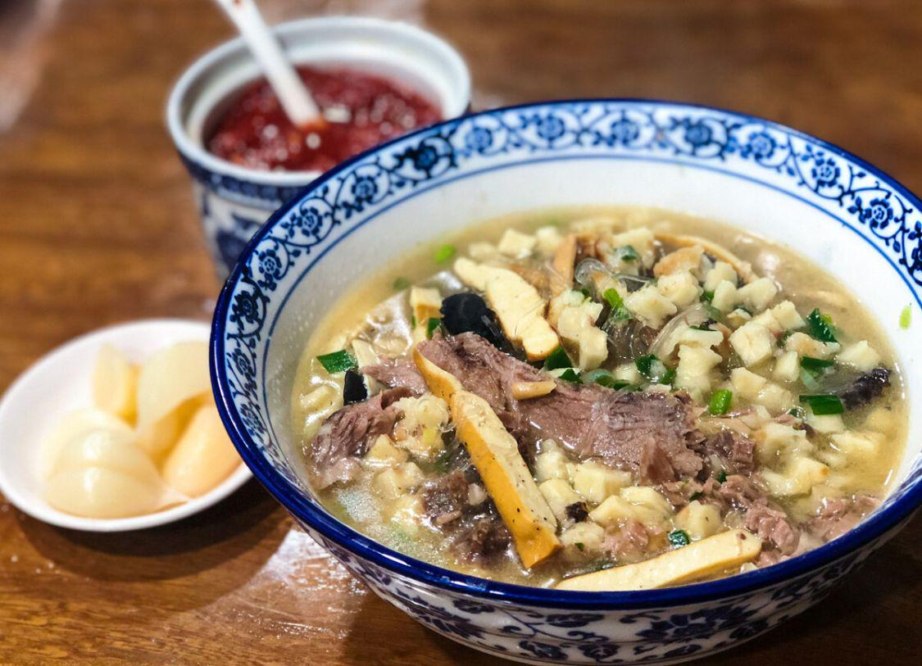
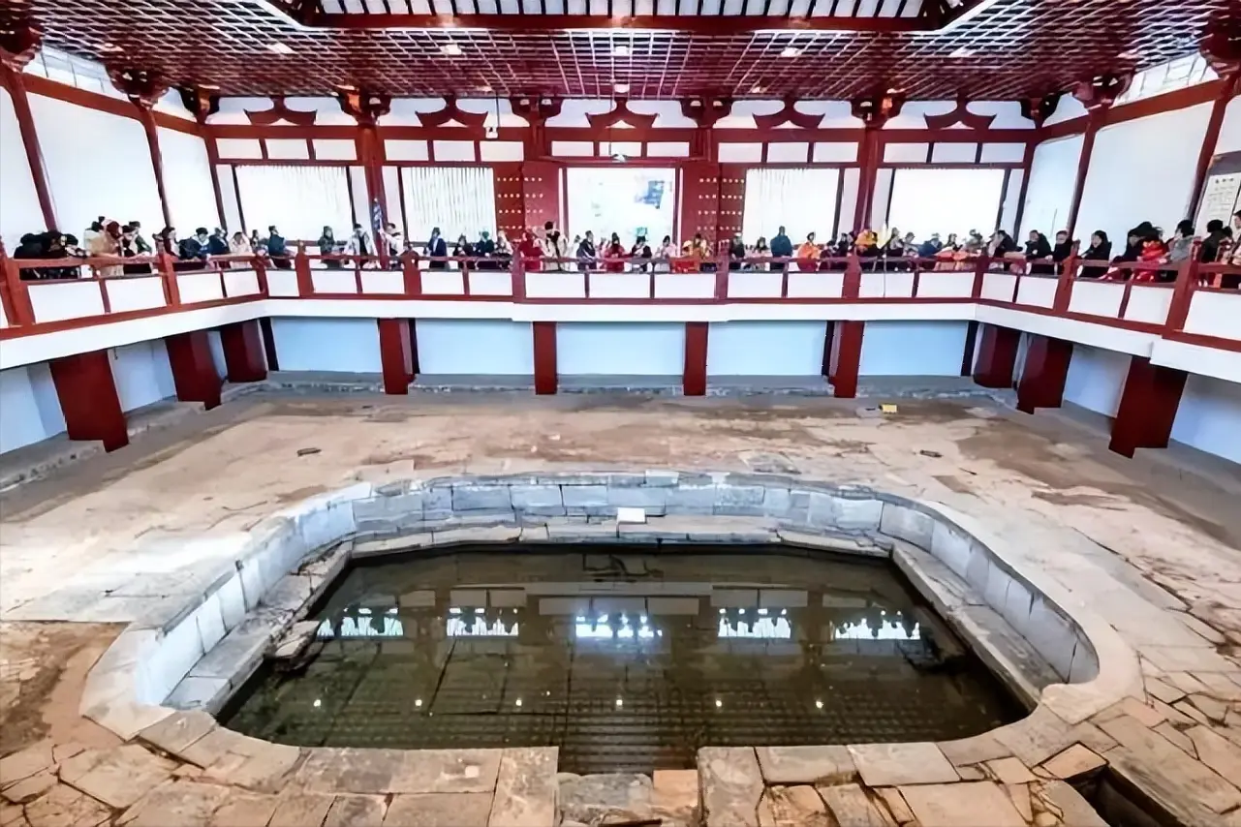
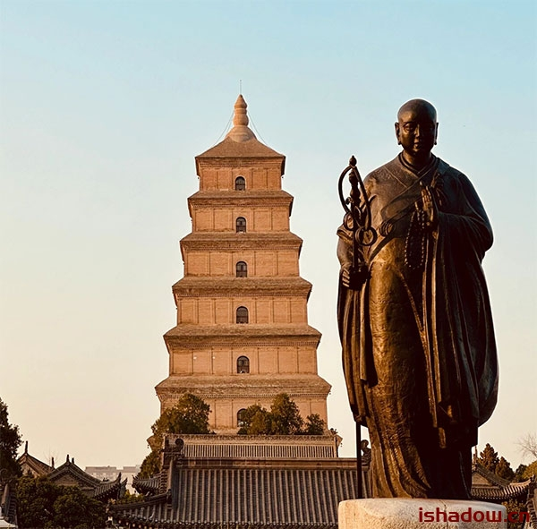
"Sanqin Package"
Liangpi、Roujiamo、Bingfeng Soda
Yangrou Paomo
Pita Bread Soaked in Lamb Soup
Huaqing Palace
Royal Bath 1277 years ago
Dayan Pagoda
Where Xuanzang preserved the sutras 1372 years ago

Slide 4

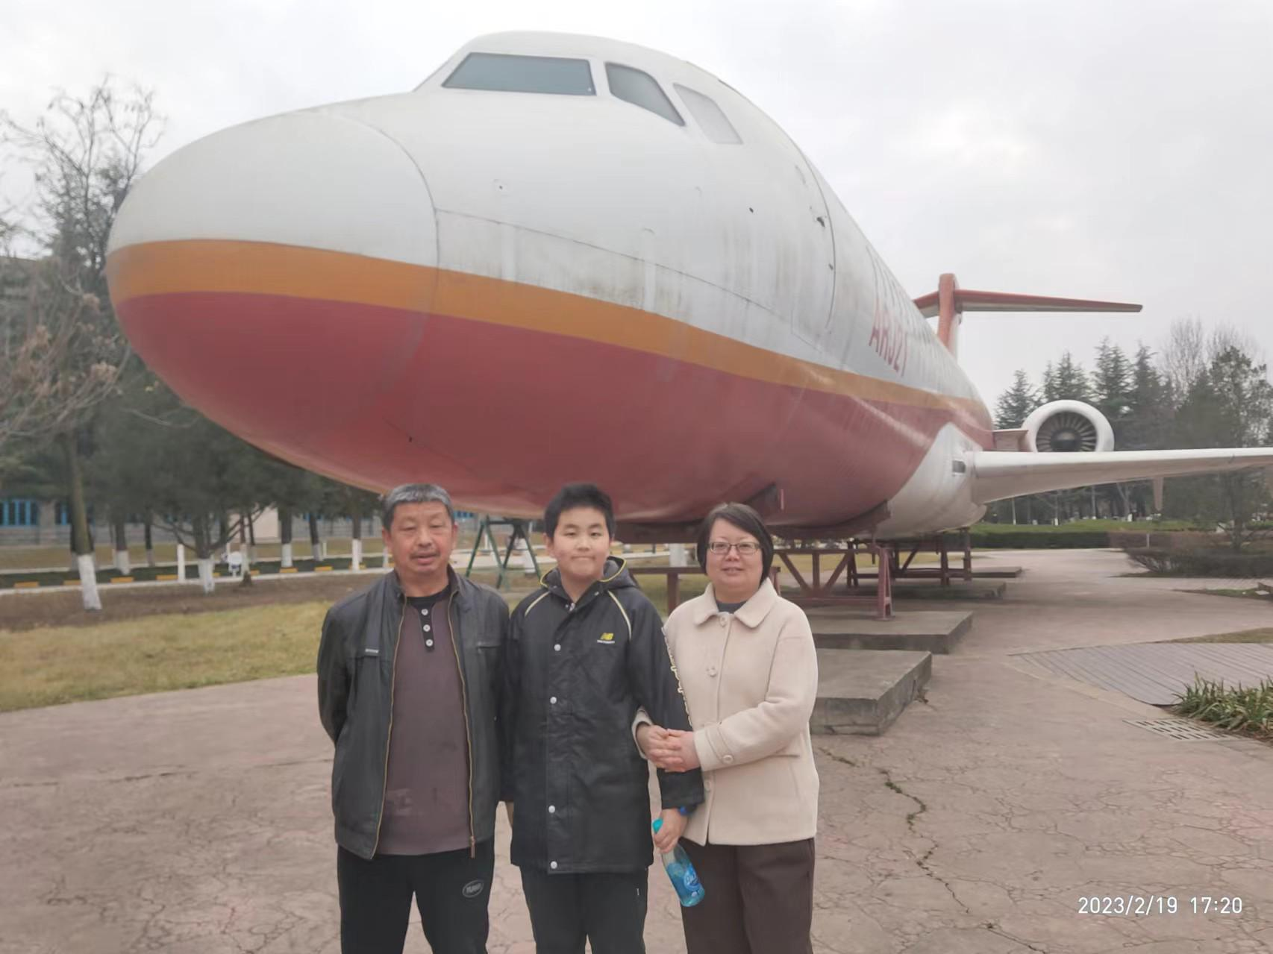
My Family

Slide 5
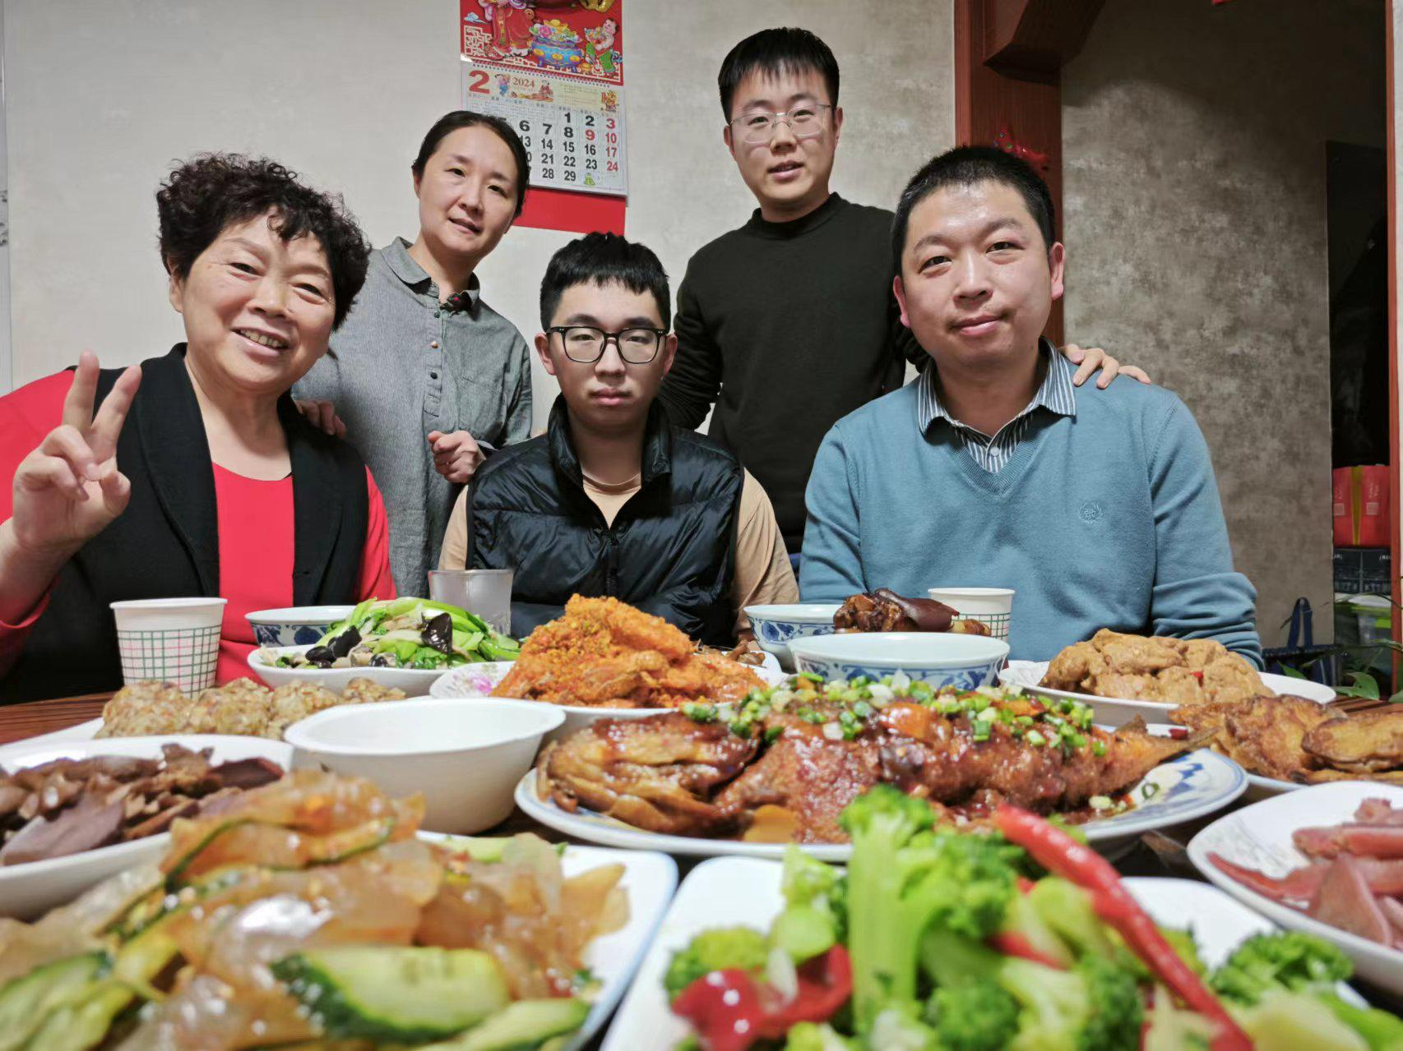
My Family

Slide 6



Education
Undergraduate
Graduate
Northwestern Polytechnical University
Xi'an Jiaotong University
Major：Computer Science and Technology
Major：Software Engineering

Slide 7
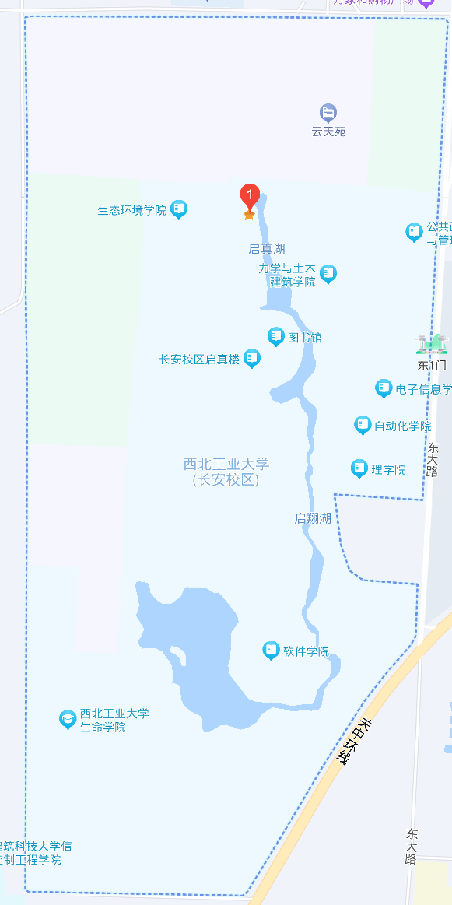
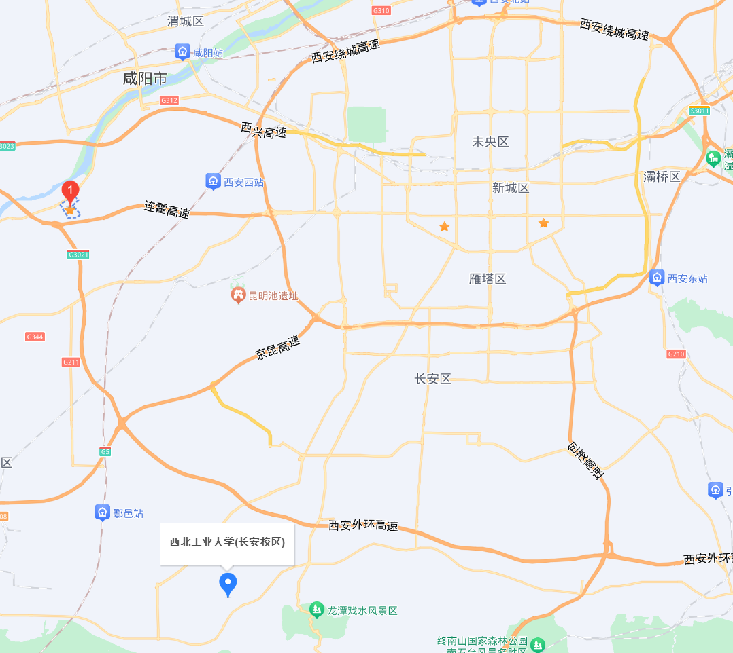
Northwestern Polytechnical University
at the east and west ends of Friendship Road

Slide 8
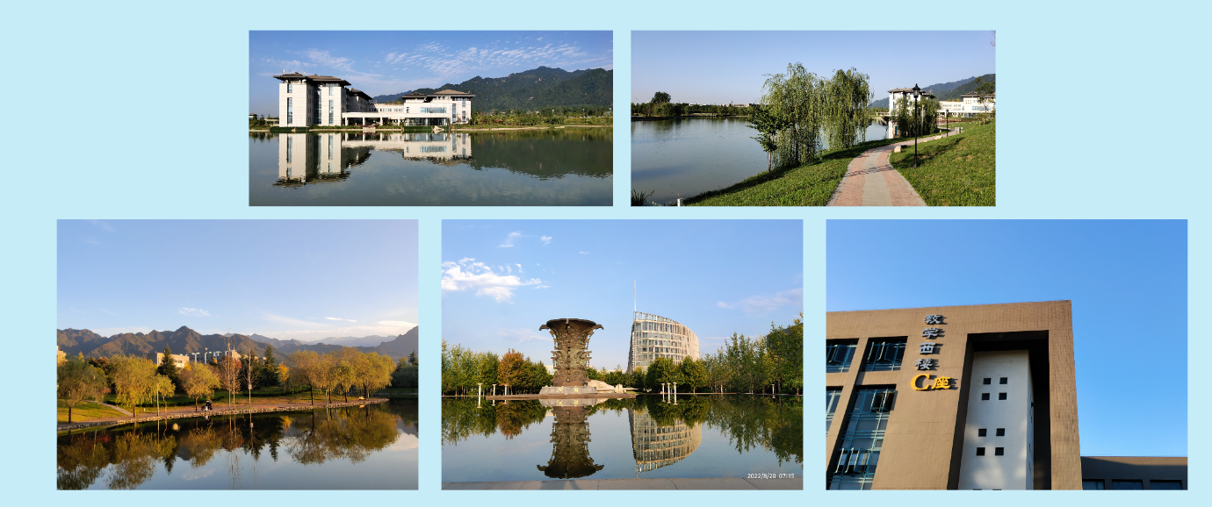
Northwestern Polytechnical University

Slide 9
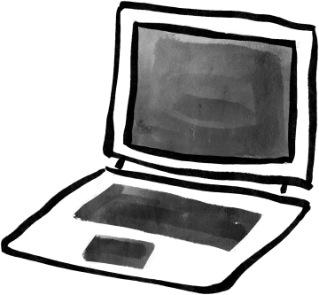


Future Professional goals
Skill Development
Master advanced programming languages (e.g., Python, Java, C++) and frameworks (e.g., React, Node.js, TensorFlow)
Attend industry conferences and workshops to connect with professionals and potential employers
Join professional organizations like the Association for Computing Machinery (ACM) or IEEE Computer Society

Slide 10
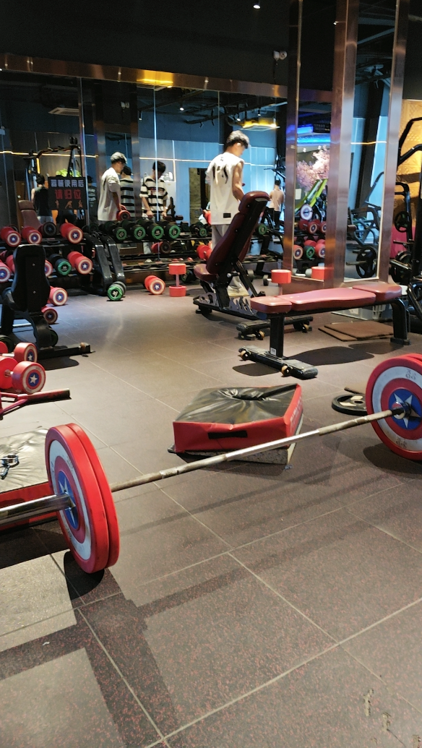
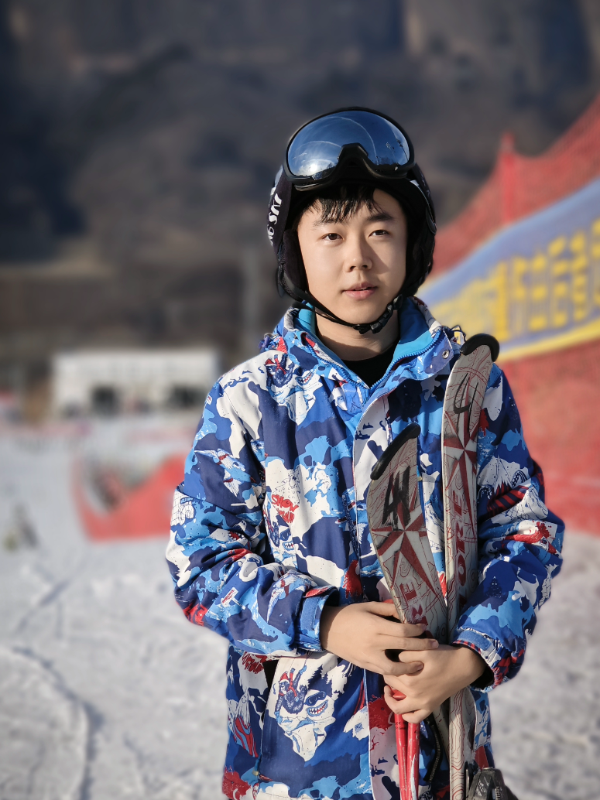
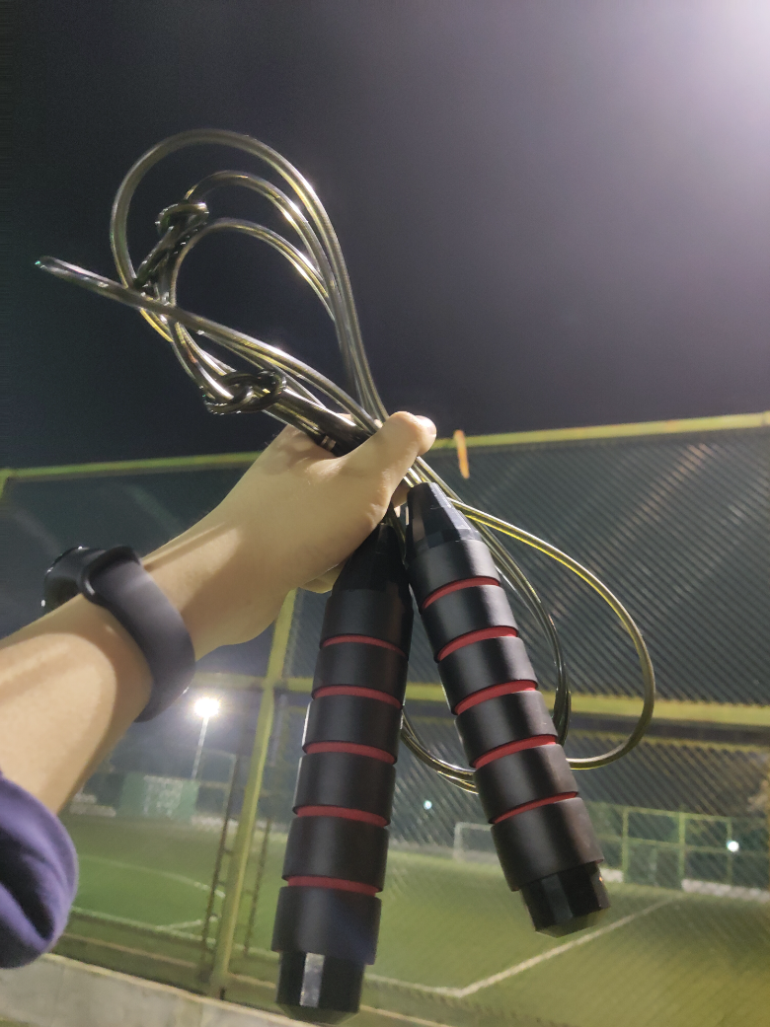
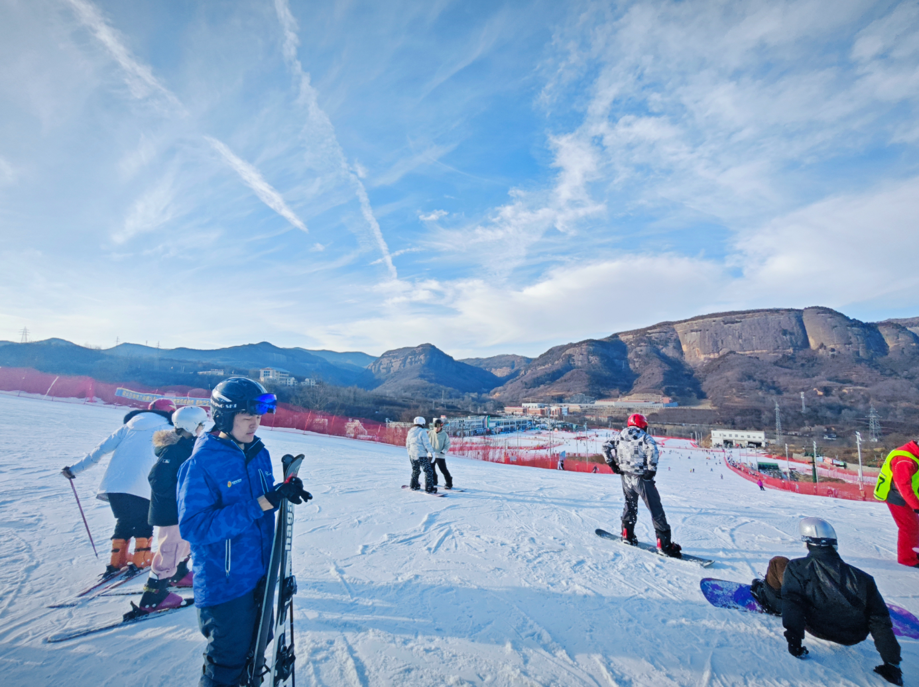
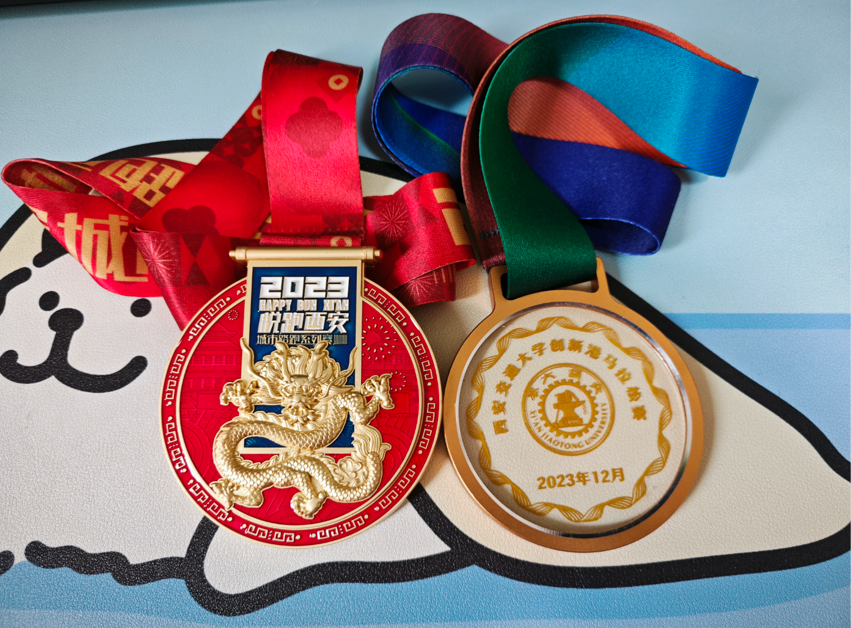
Hobbies and things l love
Sports
Video Games
Reading
Call of Duty
Pokémon
The Legend of Zelda
《The Three-Body Problem》
《Malevolence》

